Slide 1
Measuring IPv6 Performance
Geoff Huston
APNIC Labs

Slide 2
What are we looking at:
How “reliable” are IPv6 connections?
How “fast” are IPv6 connections?

Slide 3
What are we looking at:
How “reliable” are IPv6 connections?
How “fast” are IPv6 connections?
Do all TCP connection attempts succeed?
Is V6 slower than V4?

Slide 4
The Measurement Technique
Embed a script in an online ad
Have the script generate a set of URLs to fetch
Examine the packets seen at the server to determine reliability and RTT

Slide 5
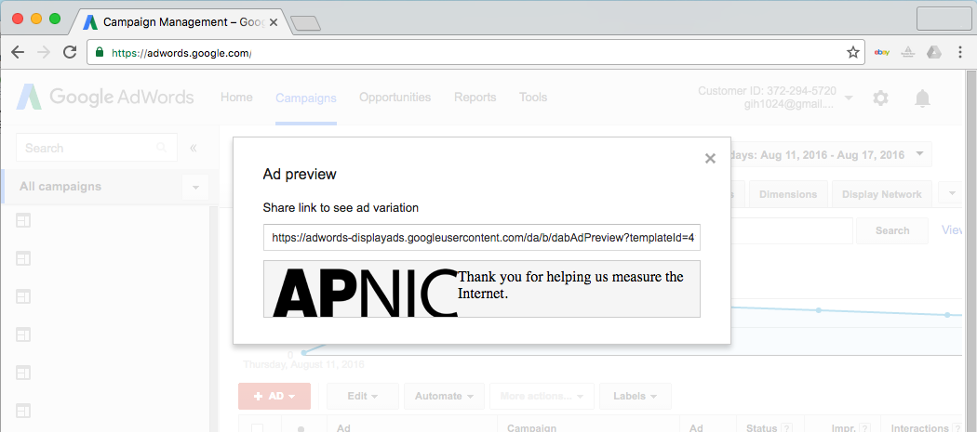
How We Measure
We use an online ad to present a sequence of small fetches to the user’s browser

Slide 6
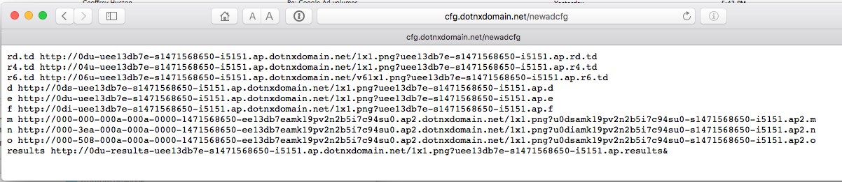
How We Measure
The sequence of tests is used to test a number of types of actions including fetches of IPv4,
IPv6 and Dual stack

Slide 7
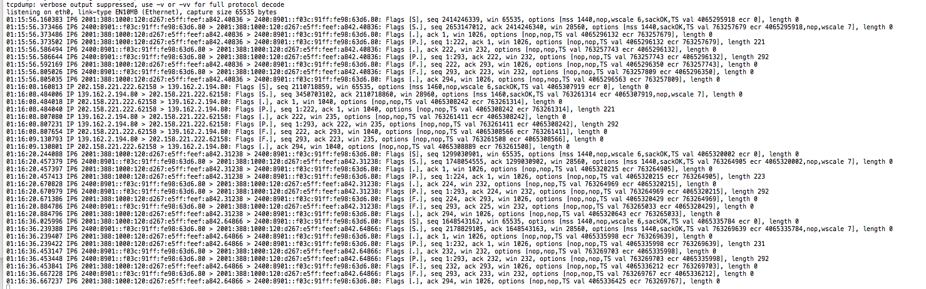
How We Measure
We use tcpdump to record all packet activity at the experiment’s servers

Slide 8
How Much do We Measure?

Slide 9
What are we looking at:
How “reliable” are IPv6 connections?
How “fast” are IPv6 connections?
Do all TCP connection attempts succeed?
Is V6 slower than V4?

Slide 10
What we see: Connection Failure
Outbound SYN
client
server
Busted SYN ACK
Return path
What the server sees is an incoming SYN, but no matching incoming ACK

Slide 11
IPv4 Connection Failure
0.22% Failure Rate

Slide 12
IPv4 Failures
IPv4 failures are around 1 in 500
And we are pretty sure its NOT:
  Auto-tunnelling
  Lousy CPE firmware
  Strange firewall filters
So what is the reason for this residual asymmetric failure rate?
Is it asymmetric routing connectivity?

Slide 13
Daily IPv6 Failures
6to4 failure: around 10%
Average IPv6 failure: around 2%
Unicast IPv6 failure: around 1.5%

Slide 14
Daily IPv6 Failures
1.5% Failure Rate
Unicast IPv6 shows moderate reliability

Slide 15
IPv6 Failures
1.5% failure for unicast V6 is still unacceptable!
Why is this happening?
  Auto-tunnelling?
  Lousy CPE firmware?
  Strange firewall filters?
  Asymmetric routing

Slide 16
Is IPv6 failure uniformly distributed?

Slide 17
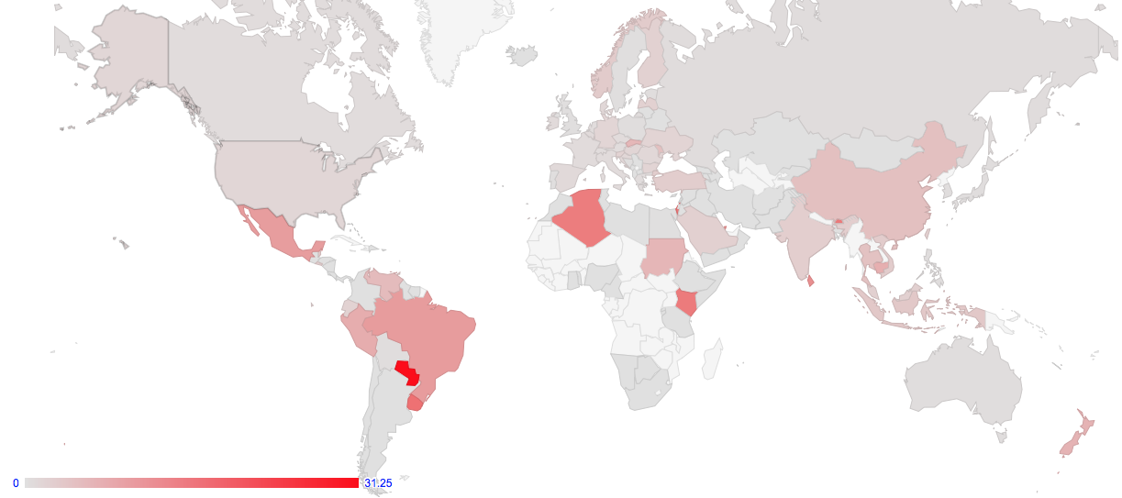
Is IPv6 failure uniformly distributed?

Slide 18
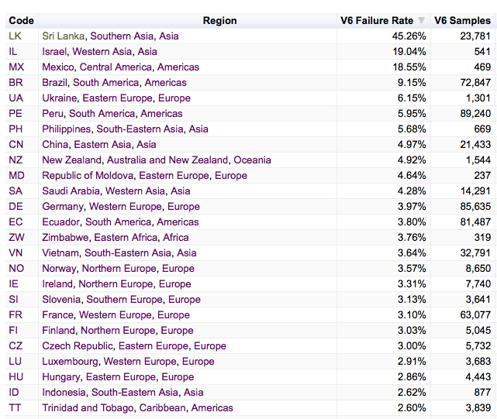
V6 Failure by Country

Slide 19
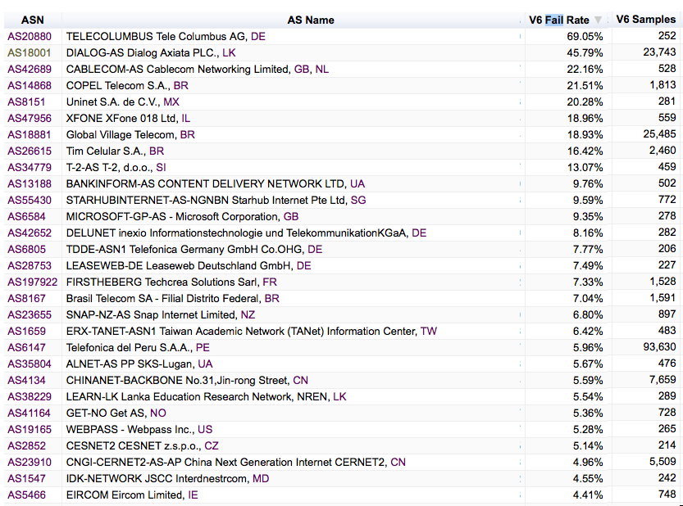
V6 Failure by Network

Slide 20
A cautionary note
These are “single shot” measurements rather than sustained repeated test, so there is some noise component here
Its also likely that connection failure is related to consumer equipment rather than network-level failure, as a network level failure would conventionally give a failure rate closer to 100%

Slide 21
What are we looking at:
How “reliable” are IPv6 connections?
How “fast” are IPv6 connections?
Do all TCP connection attempts succeed?
Is V6 slower than V4?

Slide 22
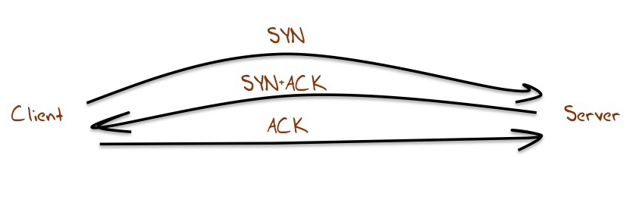
Let’s look at TCP SYNs

Slide 23
Let’s look at TCP SYNs
1 RTT interval

Slide 24
Why SYNs?
Every TCP session starts with a SYN handshake
Its typically a kernel level operation, which means that there is little in the way of application level interaction with the SYN exchange
On the downside there is only a single sample point per measurement

Slide 25
Generating a comparative RTT profile
For each successful connection couplet (IPv4 and IPv4) from the same endpoint, gather the pair of RTT measurements from the SYN-ACK exchanges
  Use the server’s web logs to associate a couplet of IPv4 and IPv6 addresses
  Use the packet dumps to collect RTT information from the SYN-ACK Exchange
  Use IPv6 RTT – IPv4 RTT as the metric

Slide 26
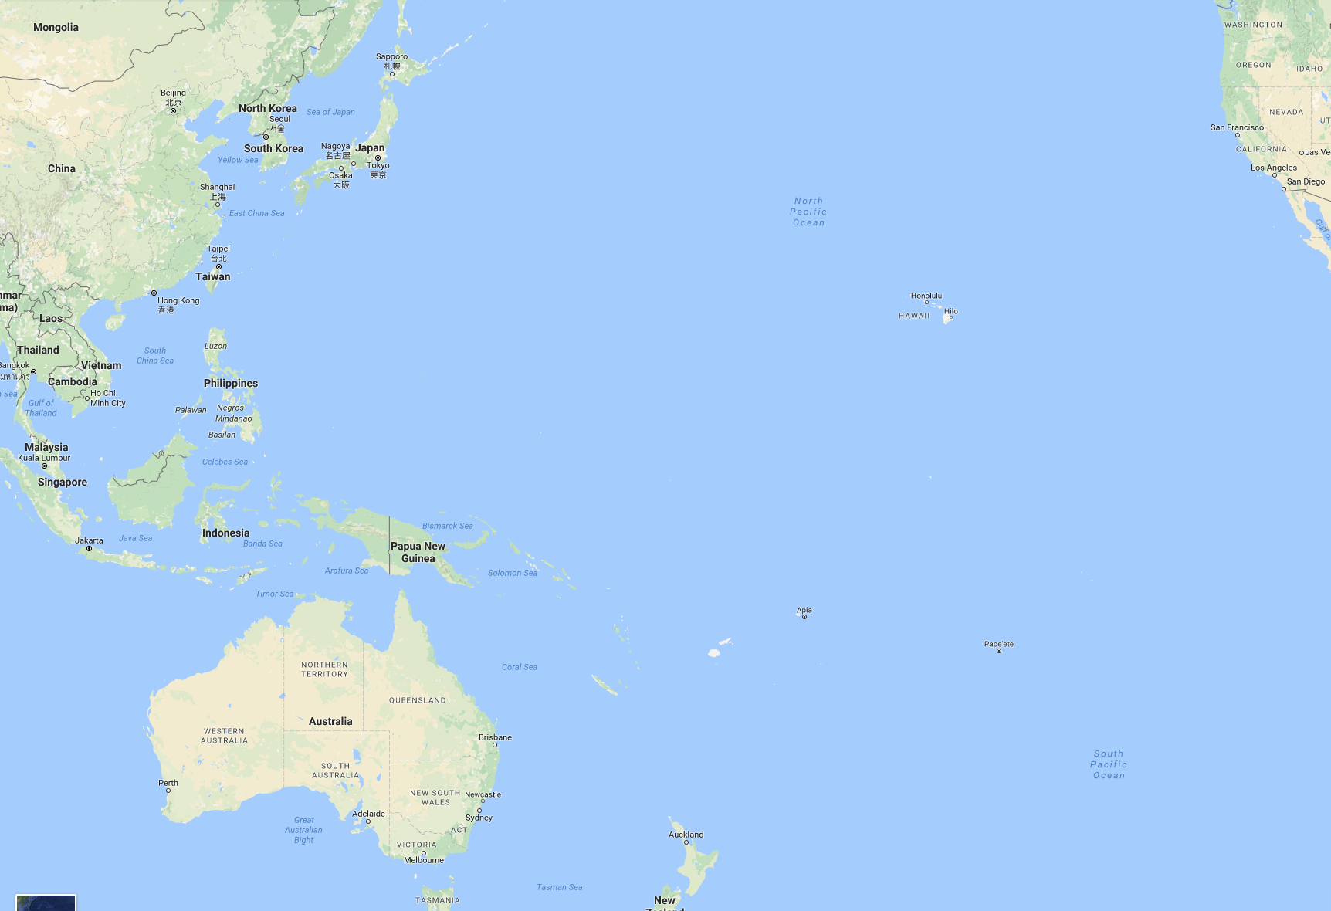
An Example of Path Divergence
$ traceroute from Singapore to Canberra, IPv4
traceroute to 202.158.xxxx.yyy, 30 hops max, 60 byte packets
1 103.3.60.3 0.672ms 0.796ms 0.899ms
2 139.162.0.9 0.754ms 0.708ms 0.732ms
3 te0-1-0-21.br03.sin02.pccwbtn.net 1.697ms 0.760ms 0.726ms
4 ntt.fe3-18.br01.sin02.pccwbtn.net 69.526ms 69.644ms 69.754ms
5 ae-10.r20.sngpsi05.sg.bb.gin.ntt.net 60.702ms 68.474ms 68.469ms
6 ae-8.r22.snjsca04.us.bb.gin.ntt.net 168.447ms 168.532ms 168.138ms
7 ae-19.r01.snjsca04.us.bb.gin.ntt.net 167.489ms 170.665ms 178.832ms
8 xe-0-8-0-21.r01.snjsca04.us.ce.gin.ntt.net 330.084ms 323.556ms 329.772ms
9 xe-1-0-1.pe1.msct.nsw.aarnet.net.au 330.020ms 323.738ms 334.474ms
10 et-3-3-0.pe1.rsby.nsw.aarnet.net.au 327.788ms 334.157ms 328.199ms
11 138.44.161.6 323.644ms 319.455ms 323.563ms
12 202.158.xxx.yyy 319.885ms 333.933ms 325.014ms
$ traceroute from Canberra to Singapore, IPv4
traceroute to 139.162.xxx.yyy, 64 hops max, 52 byte packets
1 202.158.x.y 0.682ms 0.388ms 0.313ms
2 xe-5-0-4-205.pe1.actn.act.aarnet.net.a 0.721ms 0.828ms 0.674ms
3 et-0-3-0.pe1.rsby.nsw.aarnet.net.au 4.548ms 4.733ms 4.533ms
4 et-7-1-0.pe1.brwy.nsw.aarnet.net.au 4.734ms 5.418ms 4.745ms
5 et-0-3-0.pe1.bkvl.nsw.aarnet.net.au 5.117ms 5.512ms 5.524ms
6 xe-0-0-0.bb1.b.sea.aarnet.net.au 148.017ms 148.019ms 148.131ms
7 ge3-0.cr02.sea01.pccwbtn.net (206.81.80.13) 148.469ms 148.059ms 148.429ms
8 tenge0-2-0-14.br03.sin02.pccwbtn.net 319.435ms 325.053ms 319.117ms
9 tenge0-2-0-15.br03.sin02.pccwbtn.net 319.257ms 332.560ms 323.415ms
10 linode.te0-1-0-21.br03.sin02.pccwbtn.net 323.723ms 323.627ms 323.587ms
11 139.162.aaa.bbb 334.609ms 347.243ms 347.220ms
12 139.162.xxx.yyy 325.186ms 338.209ms 325.603ms
IPv4
We are seeing path symmetry, bouncing off the US West Coast

Slide 27
An Example of Path Divergence
$ traceroute from Singapore to Canberra, IPv6
traceroute6 to 2001:388:1000:110:e4d:e9ff:x:y, 30 hops max, 80 byte packets
1 2400:8901::5287:89ff:fe40:9fc1 0.897ms 0.912ms 1.051ms
2 2400:8901:1111::1 0.851ms 0.827ms 0.792ms
3 2001:cb0:2102:2:f::1 0.364ms 0.333ms 0.516ms
4 2001:cb0:2102:2:f::1 0.502ms 0.461ms 0.431ms
5 2001:cb0:21f0:1:17::2 2.512ms 2.176ms 3.445ms
6 2001:cb0:21f0:1:17::2 2.354ms 2.382ms 1.238ms
7 10gigabitethernet3-5.core1.sin1.he.net 1.080ms 1.034ms 1.020ms
8 10ge1-5.core1.tyo1.he.net 88.053ms
10ge1-16.core1.hkg1.he.net 39.369ms
10ge1-5.core1.tyo1.he.net 88.084ms
9 10ge1-5.core1.tyo1.he.net 88.157ms
100ge8-1.core1.sea1.he.net 192.408ms 192.642ms
10 100ge8-1.core1.sea1.he.net 192.631ms 192.608ms 196.154ms
11 xe-1-0-1.pe2.brwy.nsw.aarnet.net.au 214.176ms 186.238ms 213.061ms
12 et-3-1-0.pe1.brwy.nsw.aarnet.net.au 211.298ms 211.300ms 214.200ms
13 et-1-1-0.pe1.rsby.nsw.aarnet.net.au 211.492ms 211.359ms 211.427ms
14 et-0-3-0.pe1.actn.act.aarnet.net.au 213.332ms 211.458ms 211.476ms
15 2001:388:1000:110:e4d:e9ff:x.y 213.274ms 213.199ms 213.169ms
$ traceroute from Canberra to Singapore, IPv6
traceroute6 to 2400:8901::f03c:91ff:a:b) 64 hops max, 12 byte packets
1 2001:388:1000:110::x:y 0.808ms 0.899ms 1.586ms
2 xe-5-0-4-205.pe1.actn.act.aarnet.net.au 1.633ms 0.646ms 0.578ms
3 et-0-1-0.pe1.dksn.act.aarnet.net.au 0.682ms 0.649ms 0.694ms
4 et-5-3-0.pe1.crlt.vic.aarnet.net.au 8.072ms 8.086ms 8.049ms
5 et-5-1-0.pe1.wmlb.vic.aarnet.net.au 8.116ms 8.055ms 8.073ms
6 et-0-3-0.pe1.adel.sa.aarnet.net.au 17.790ms 16.984ms 17.036ms
7 et-1-1-0.pe1.prka.sa.aarnet.net.au 17.080ms 17.152ms
et-0-3-0.pe1.eper.wa.aarnet.net.au 43.319ms
8 et-0-3-0.pe1.knsg.wa.aarnet.net.au 43.357ms 43.443ms 43.353ms
9 gigabitethernet-5-1-0.bb1.b.per.aarnet.net.au 43.849ms 43.919ms 43.850ms
10 so-0-0-0.bb1.a.sin.aarnet.net.au 92.219ms 92.275ms 92.189ms
11 as6939.singapore.megaport.com 212.347ms 212.426ms 212.471ms
12 * * *
13 2400:8901:1110::2 213.924ms 213.904ms 213.717ms
14 2400:8901::f03c:91ff:a:b 213.954ms 213.393ms 213.726ms
IPv4 – IPv6
In IPv6 we are seeing path asymmetry, with outbound packets
Crossing an Indian Ocean cable, and return packets bouncing
off the US West Coast – the IPv6 RTT is 112 ms smaller than the IPv4 RTT

Slide 28
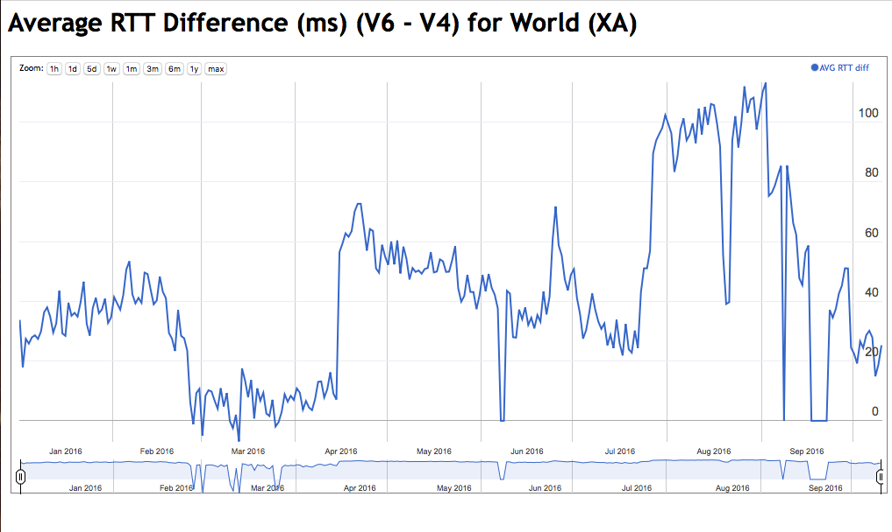
Global Results
On average IPv6 is showing 20ms – 40ms slower that IPv4

Slide 29
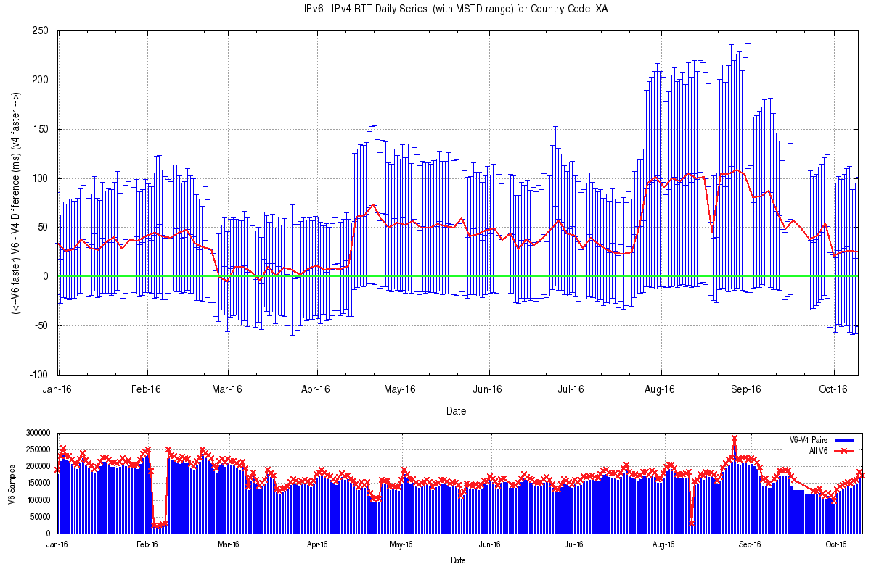
Global Results
Mean Standard Deviation per day of these measurements
Number of sample points per day

Slide 30
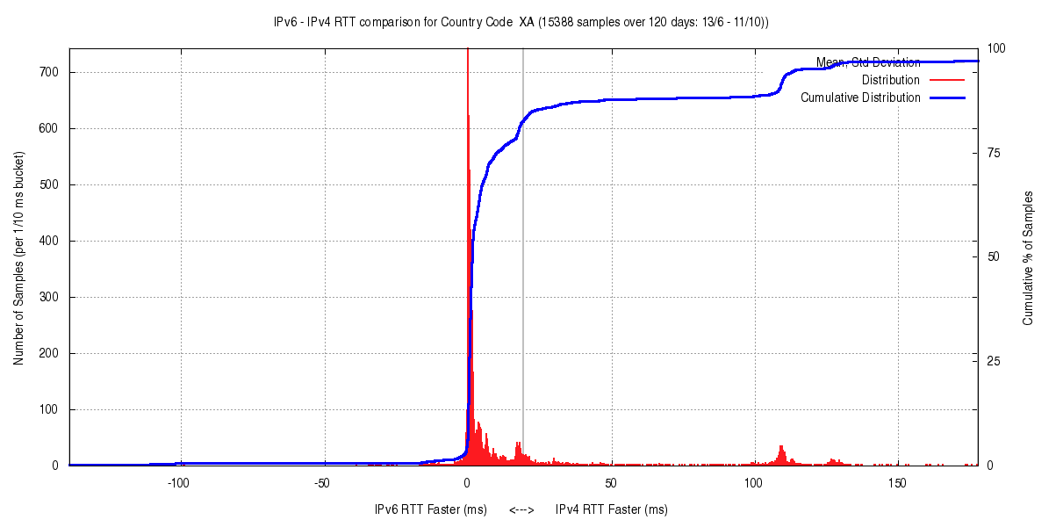
RTT Diff Distribution
120 day average
IPv6 Faster (ms)
IPv4 Faster (ms)

Slide 31
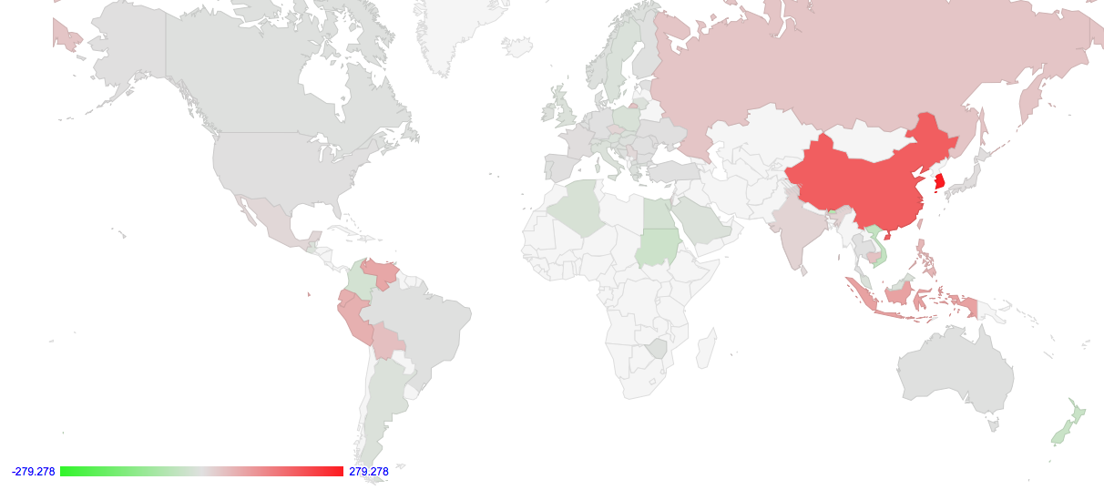
RTT Diff by Country

Slide 32
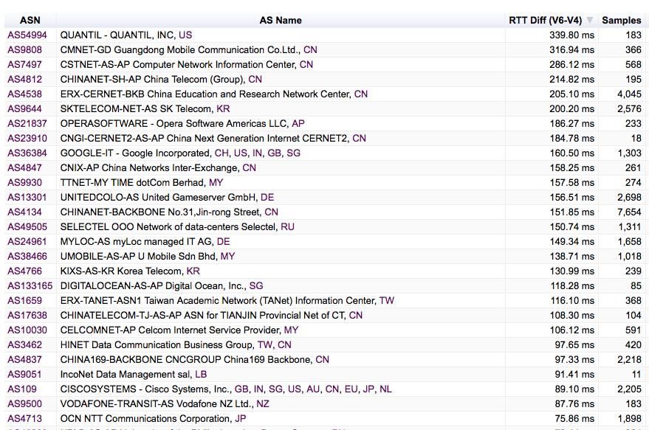
RTT Diff by Network

Slide 33
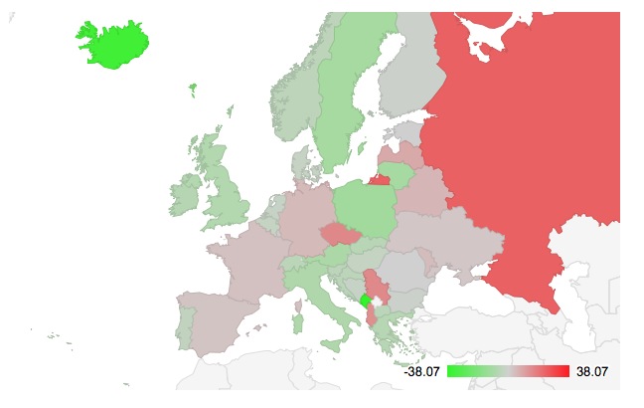
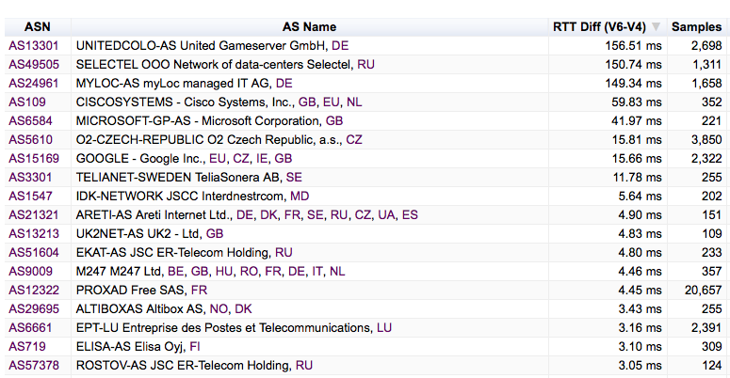
European Region
V4 faster nets

Slide 34
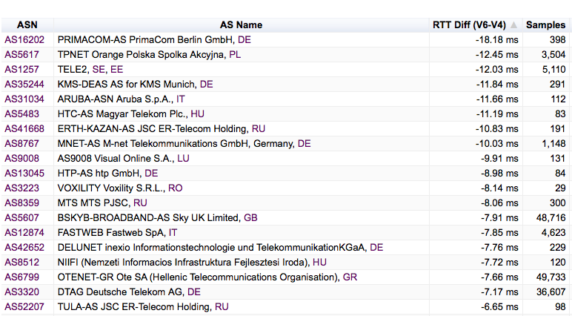
European Region
V6 faster nets

Slide 35
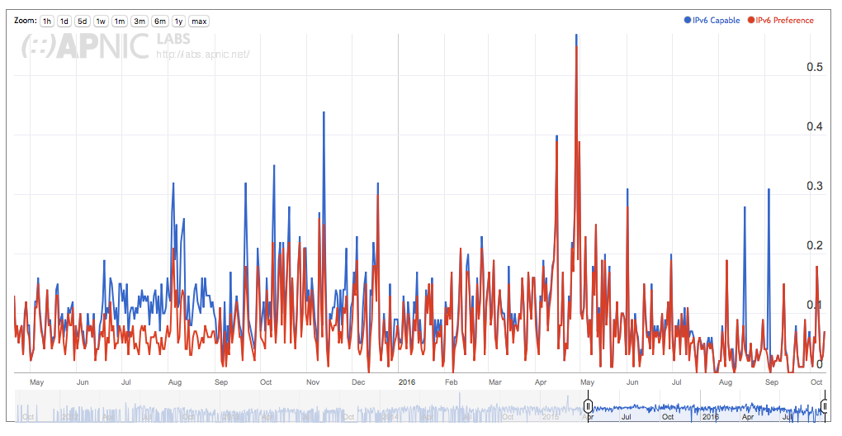
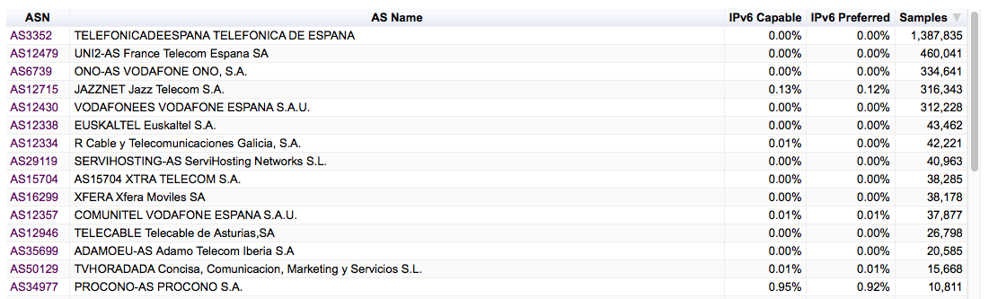
IPv6 in Spain:
Largest ISPs

Slide 36
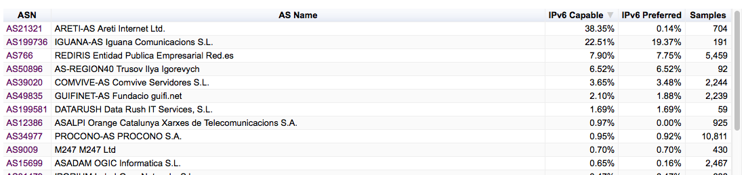
IPv6 in Spain:
IPv6 ISPs

Slide 37
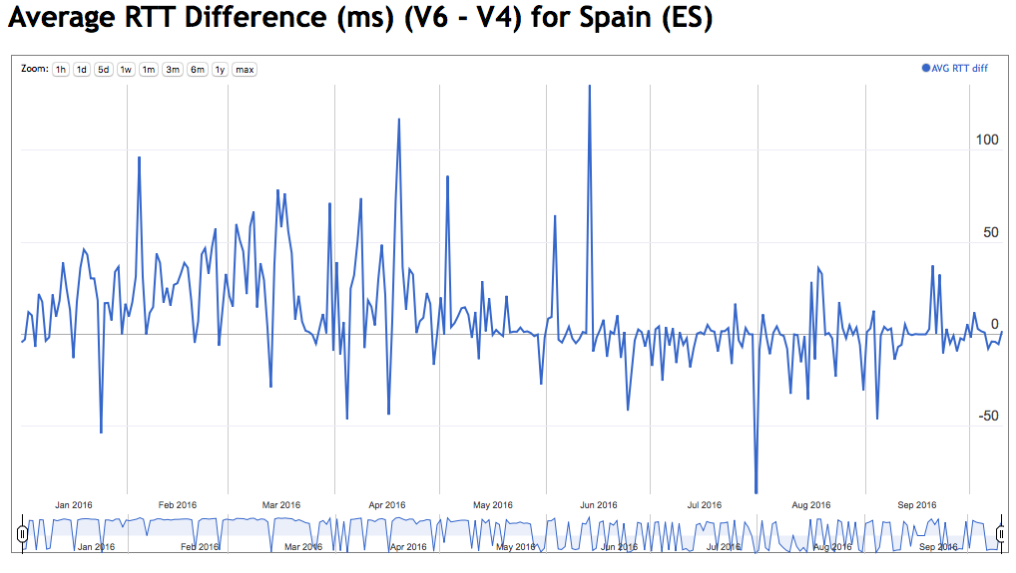
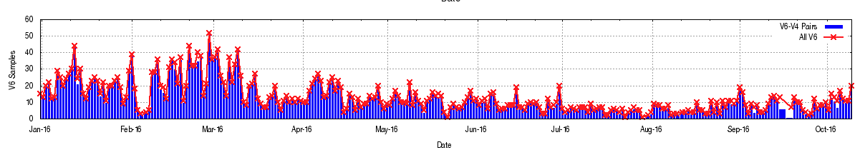

Slide 38
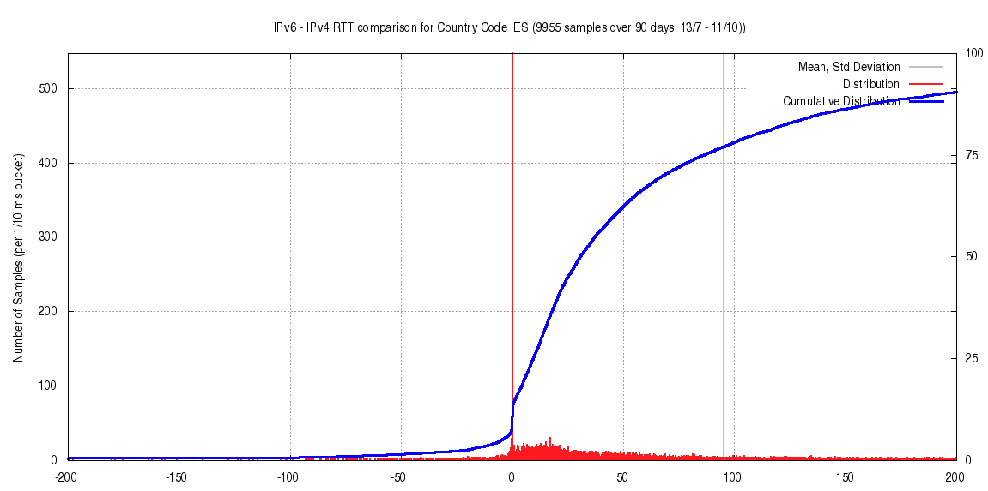
IPv6 in Spain – RTT Diff distribution

Slide 39
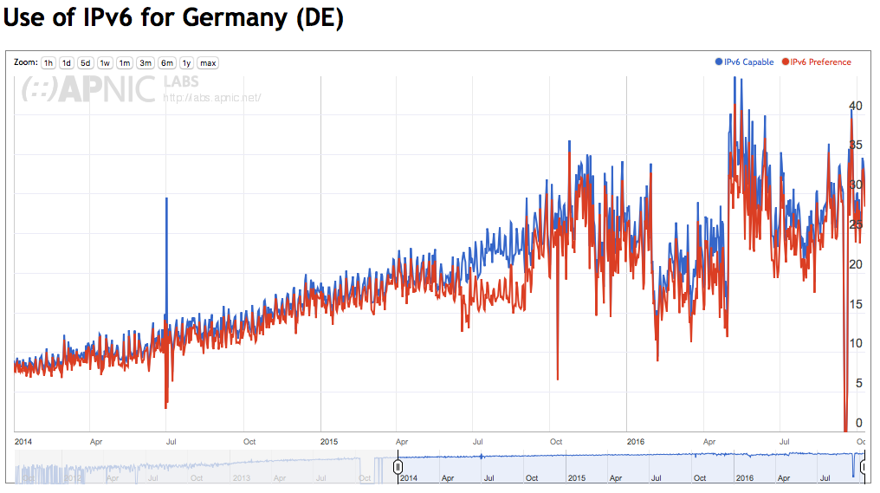
Germany

Slide 40
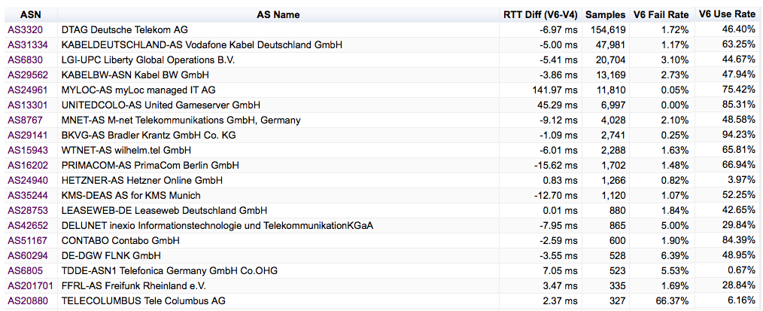
German IPv6 ISPs

Slide 41
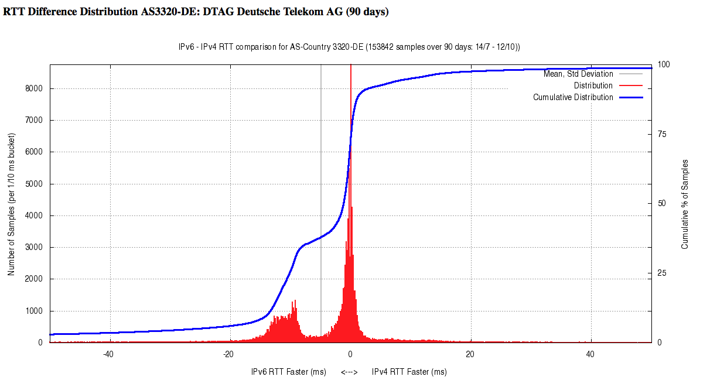
RTT Diff for DTAG – AS3320

Slide 42
Is IPv6 as “good” as IPv4?

Slide 43
Is IPv6 as “good” as IPv4?
Is IPv6 as fast as IPv4?
  Basically, yes
  IPv6 is faster about half of the time
  For 75% of unicast cases, IPv6 is within 10ms RTT of IPv4
  So they perform at much the same rate
  (But that’s just for unicast IPv6 - the use of 6to4 makes this a whole lot worse!)

Slide 44
Is IPv6 as “good” as IPv4?
Is IPv6 as robust as IPv4?
  IPv4 average connection reliability currently sits at 0.2%
  The base average failure rate of Unicast V6 connection attempts at 1.5% of the total V6 unicast connections is not brilliant.
  (6to4 is terrible at this!)
  It could be better.
  It could be a whole lot better!

Slide 45
Is IPv6 as “good” as IPv4?
If you can establish a connection, then IPv4 and IPv6 appear to have comparable RTT measurements across most of the Internet
But the odds of establishing that connection are still weighted in favour of IPv4!

Slide 46
That’s it!
http://stats.labs.apnic.net/v6perf

